Slide 1
Spring is green Summer is bright Autumn is yellow Winter is white

Slide 2
The main question:
Which season is beautiful for you?

Slide 3
Match the words with the right house
[w]
Fly
windy
foggy
what
weather
rainy
sunny
Sky
my

Slide 4
Let’s check
[w]
Windy
Weather
what
sunny
foggy
rainy
fly
my
sky

Slide 5
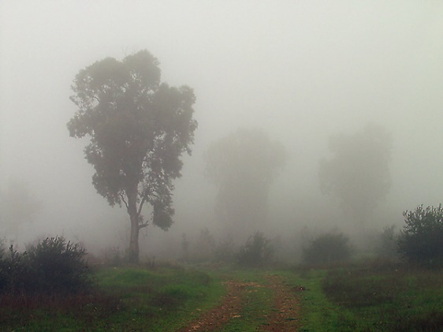
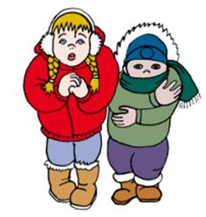
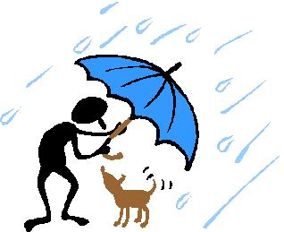
It’s …

Slide 6
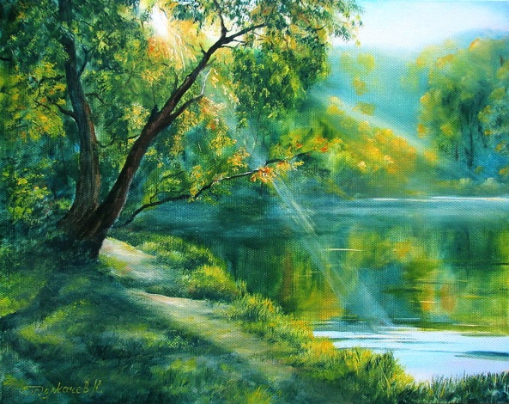
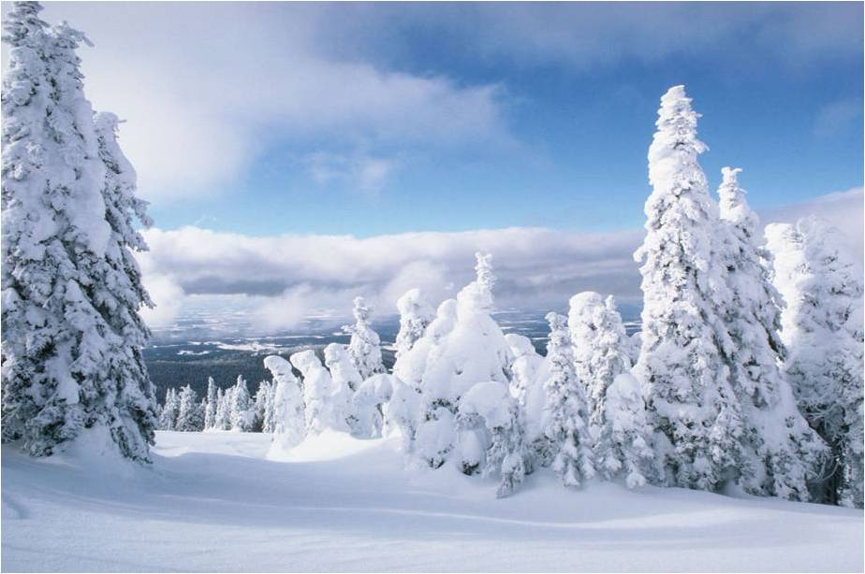
1
-Is it …?
-No, it isn’t.
-Yes, it is.
5
4
3
2
6
7
8
9

Slide 7
Let’s check your homework

Slide 8
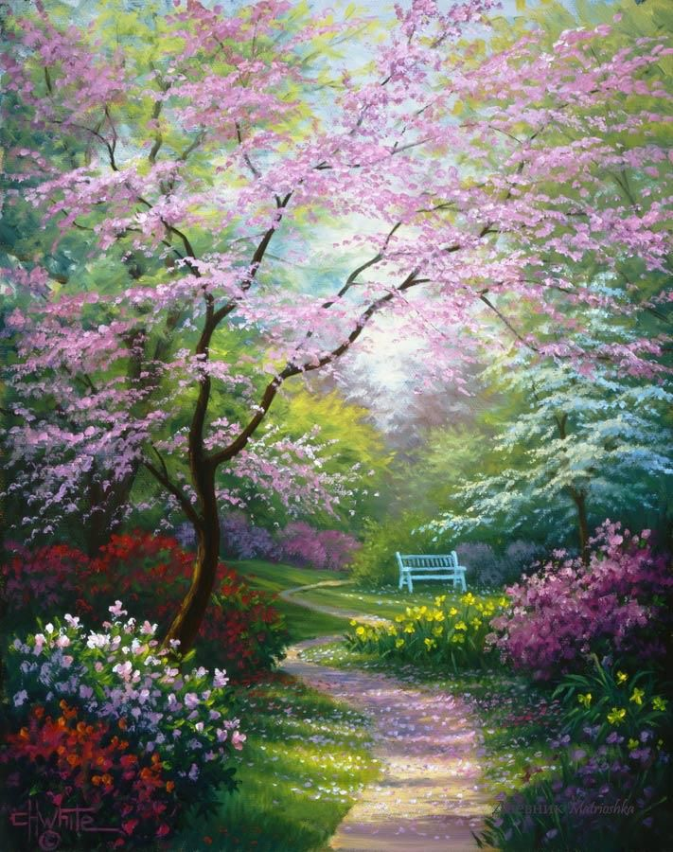
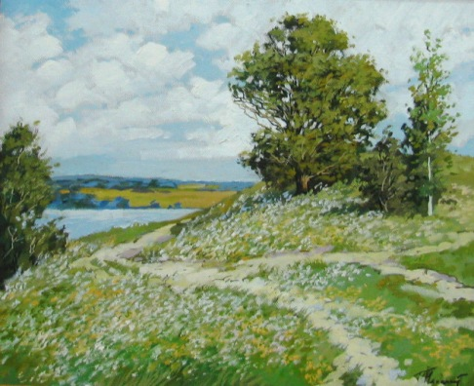
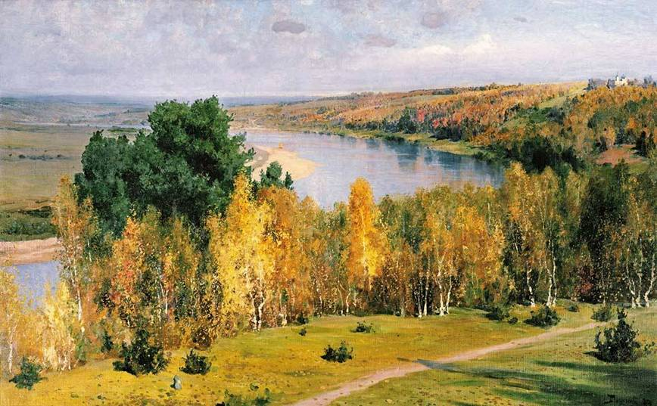
What season is it?

Slide 9
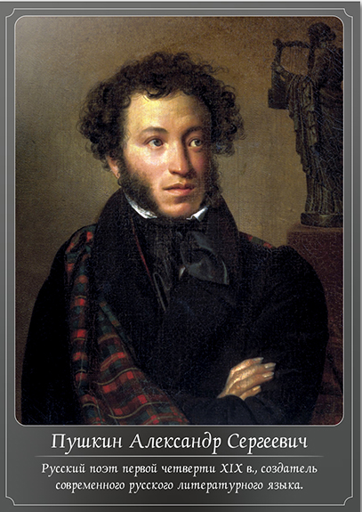
Унылая пора! Очей очарованье! Приятна мне твоя прощальная
краса — Люблю я пышное природы
увяданье, В багрец и в золото одетые леса, В их сенях ветра шум и свежее
дыханье, И мглой волнистою покрыты
небеса, И редкий солнца луч,
и первые морозы, И отдаленные седой зимы угрозы.

Slide 10
I. Levitan «Golden autumn»

Slide 11
Т. Kinkade «Spring»

Slide 13
P. Maslennikov «Winter»

Slide 14
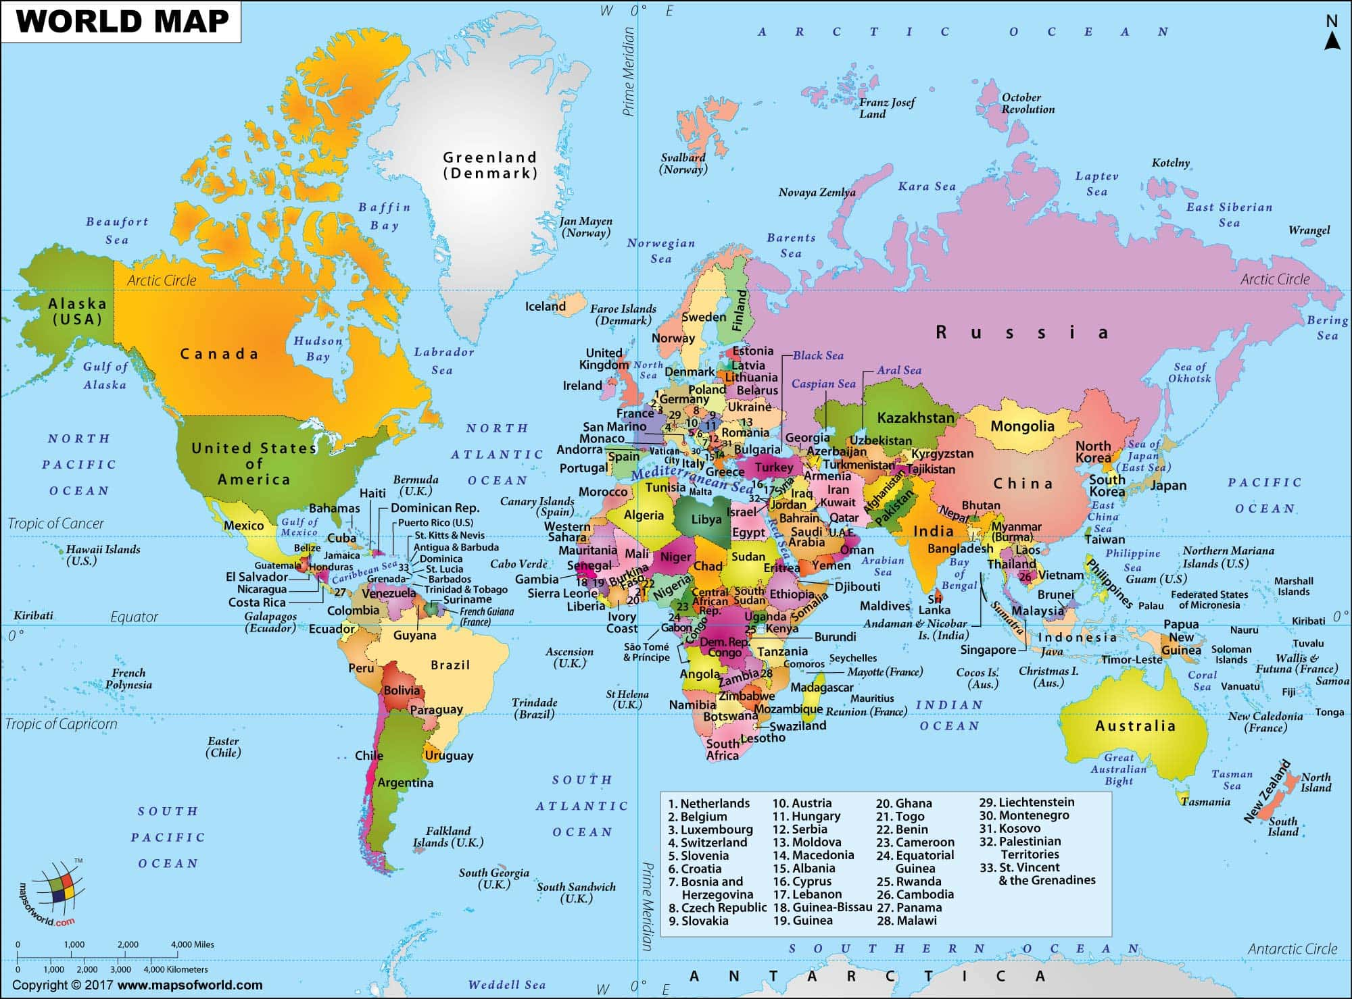
International weather forecast.
Russia
Canada
England
France
Japan
Mexico
Australia

Slide 15
Answer the questions
What’s the name of the tiger?
Bim b) Tim c) Sid
2) It’s cold in...
Australia b) Mexico c) Russia
3) What’s the weather like in England?
a)It’s hot. b) It’s foggy c) It’s sunny.
4) What’s the weather like in Mars?
- b) It’s rainy. c) It’s sunny.
5) Is it snowy in Canada?
a) Yes, I do. b) No, it isn’t. c) Yes, it is.

Slide 17
Describe the pictures in groups.
Us
Use this plan:
It’s_________.
It’s ____ and____ in____.
It isn’t____. It isn’t____.
The trees are_____ and ______.
The sky is_____.
The snow is/ flowers are_____and_____.
The ground is________.
We can _____ and_____ in_____.

Slide 18
P. Maslennikov
«Summer day»

Slide 19
V. Polenov «Golden autumn»

Slide 20
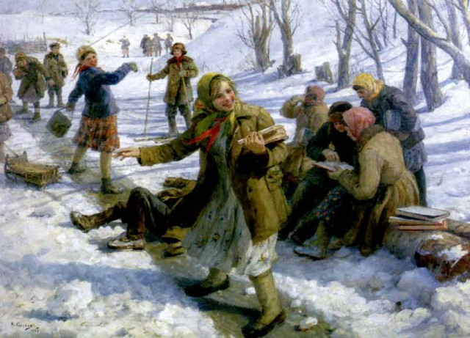
F. Sychkov
« Returning from school»

Slide 21
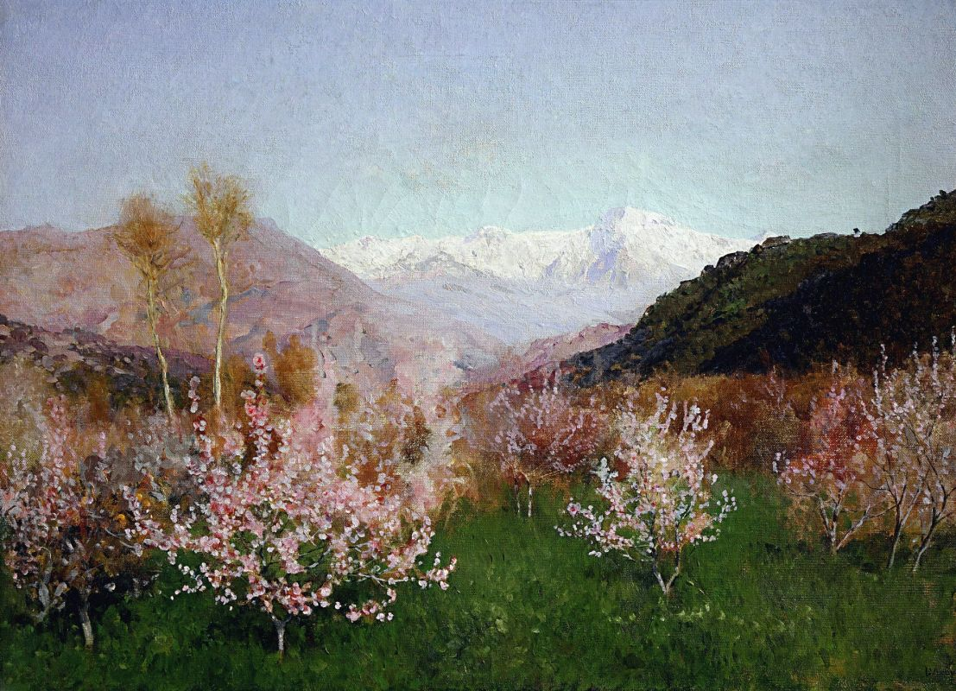
I. Levitan «Spring in Italy»

Slide 22
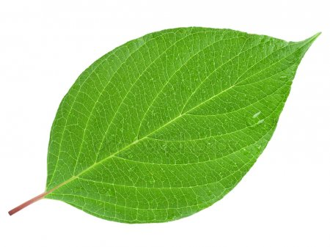
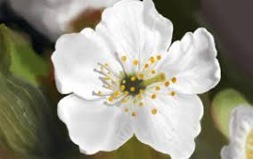
Let’s decorate our seasons’ tree!

Slide 23
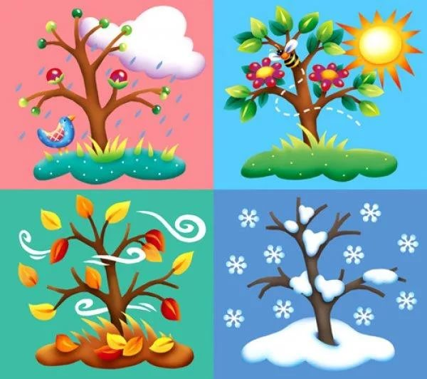
Thank you for your work!
All seasons are beautiful

