Slide 1
Our pets

Slide 3
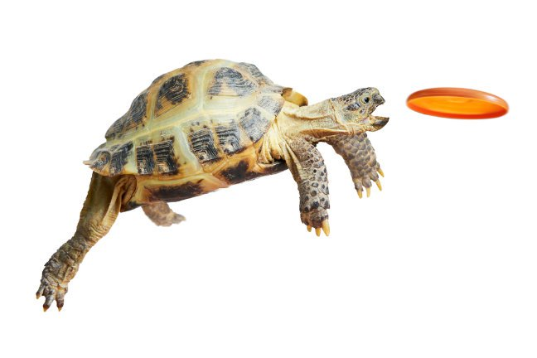
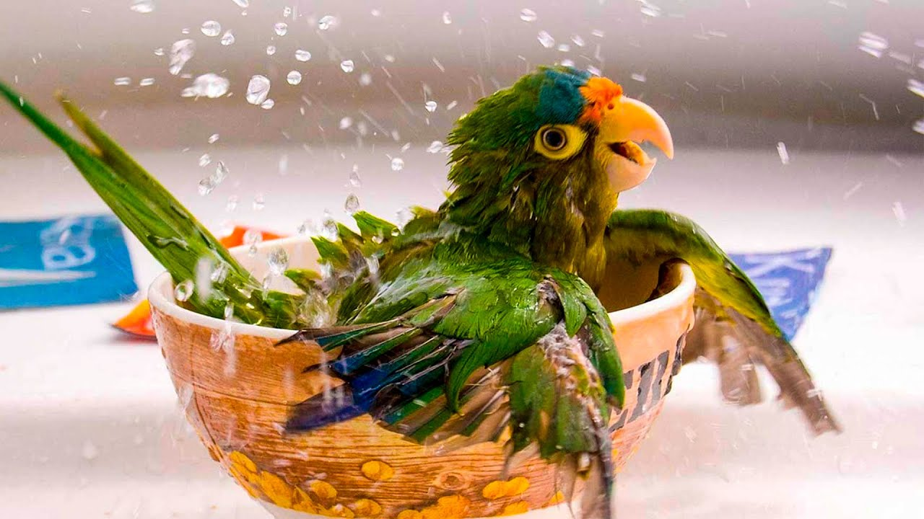
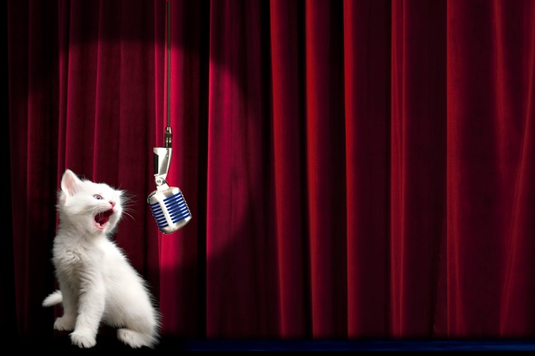
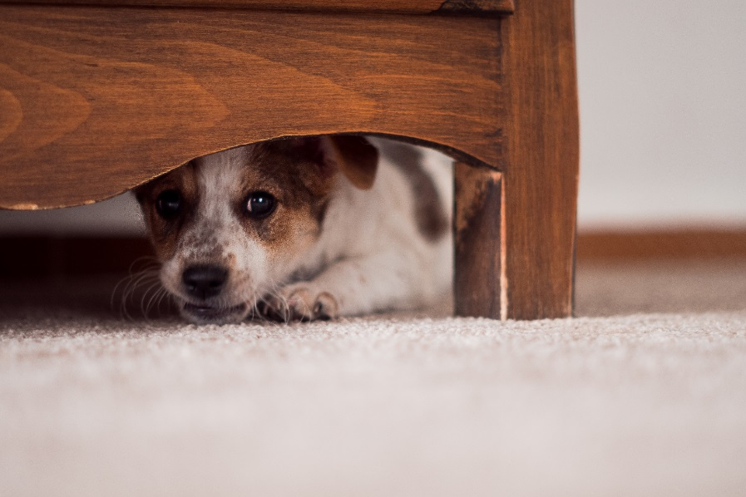
Our pets

Slide 4
What’s this?

Slide 5
What’s this?

Slide 6
What’s this?

Slide 7
What’s this?

Slide 8
What’s this?

Slide 9
What’s this?

Slide 10
What’s this?

Slide 11
Is it a budgie?

Slide 12
Is it a hamster?

Slide 13
Is it a frog?

Slide 14
Have you got a hamster?

Slide 16
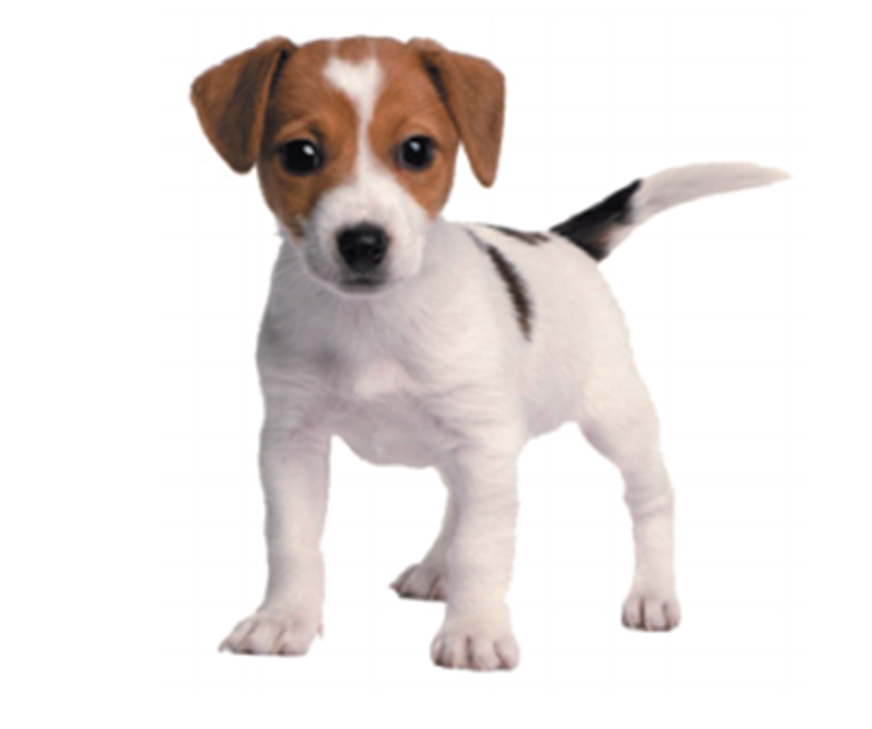
It’s a … . It can … and … .

Slide 17
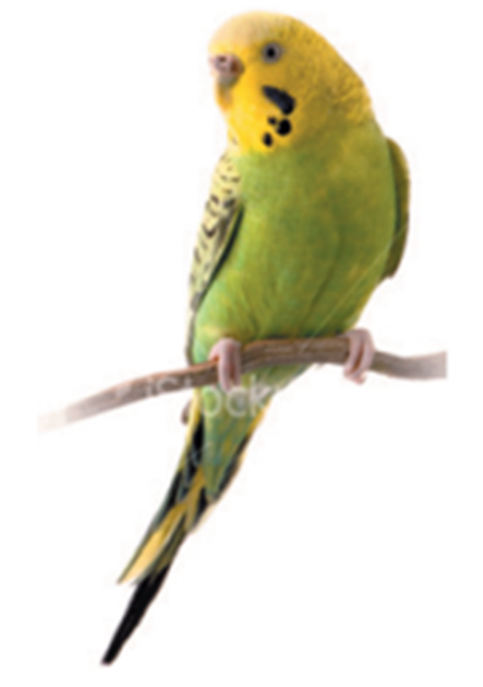
It’s a … . It can … and … .

Slide 18
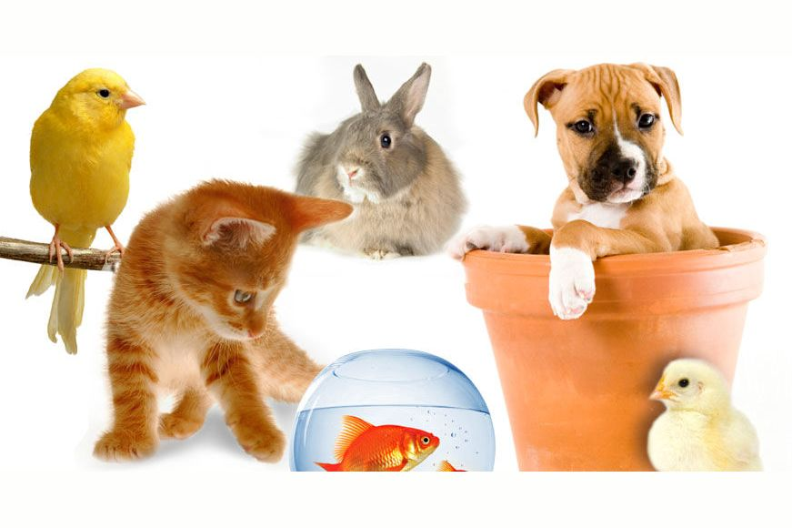
Let’s check our homework!
Speak about your pets

Slide 19
Workbook ex. P.

Slide 20
I’ve got a pet. It’s a rabbit. It’s white. It’s got a pink nose and red eyes. It can walk and jump. It can’t fly. It can’t swim. It’s nice.

Slide 21
Play a guessing game
- I’ve got a pet.
It’s grey.
It can jump. - It’s a puppy. - No, it isn’t. - It’s a rabbit. - Yes, it is!

Slide 22
Moving activity

Slide 23
What can the cat do? What can the dog do?

Slide 24
Speak about your pet

Slide 25
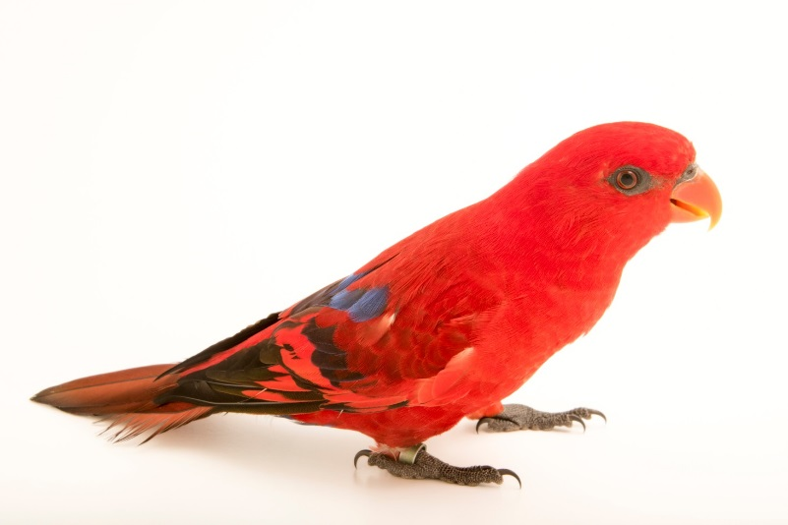
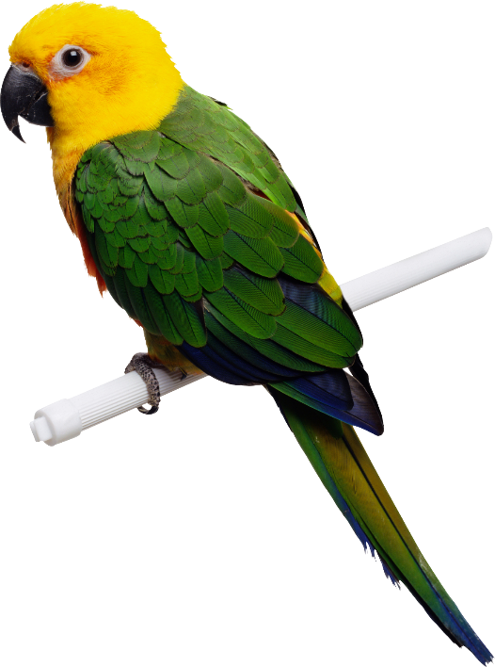
I can speak about pets. I can’t speak about pets.

Slide 26
PB ex. 3 p.115
Проп.: ex.2 p.40 (speak)

